Slide 1
MEDICAL MANAGEMENT WEBSITE - HEARTCARE
Name: Devansh
Roll Number: 2010991860
Group: G-23
Tech-Stack Used: React-JS, Json-server(for API)

Slide 2
Acknowledgment
I would like to give my heartfelt gratitude to my Frontend development teacher Mr.Rafiq for giving me this golden opportunity to build The medical management website as a project. I would like to thank him for his guidance and support and giving me this chance which helped me learn a lot of new things during the process. I would also like to thank my peers for their sincere support and motivating me during the making of this project. I hope it turns out helpful in my career growth.

Slide 3
INTRODUCTION
The medical industry’s need and importance has risen up in an immense amount during recent times. And with the rise of requirement there is also a skyrocketing in demand for no contact appointments, bringing things online and making it possible for doctors to hold meetings. So, this gives the software industry a great chance to use their skills in providing a system for patients to use in their daily lives and for doctors as well. So to make things easier, I had came up with a project which would provide a digital system of managing various appointments, prescriptions for users. Heartcare is a web application which will make things easier for its user providing them individual and relevant information that is required.

Slide 4
Technologies Used In Project:
React JS for front end design and adding functionality
CRUD OPERATIONS to add, change, and receive the data
Json-server to create a fake API using JSON data
Hooks used in React JS: useEffect, useContext, useState, useRef
CRUD operations: Add, Change, and Receive data(collective database and individual data as well)

Slide 5
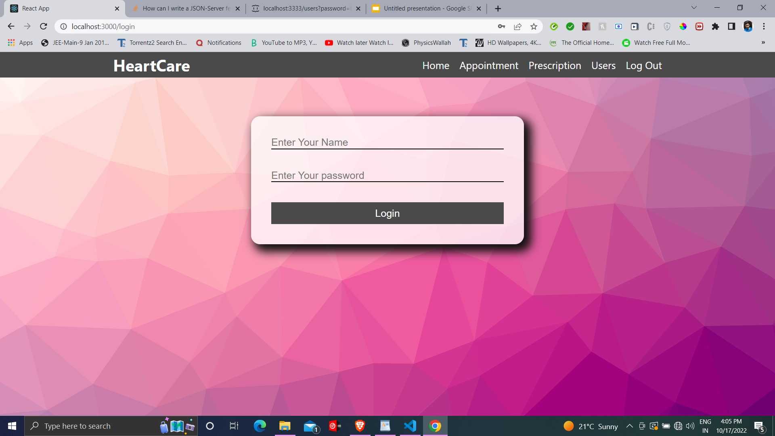
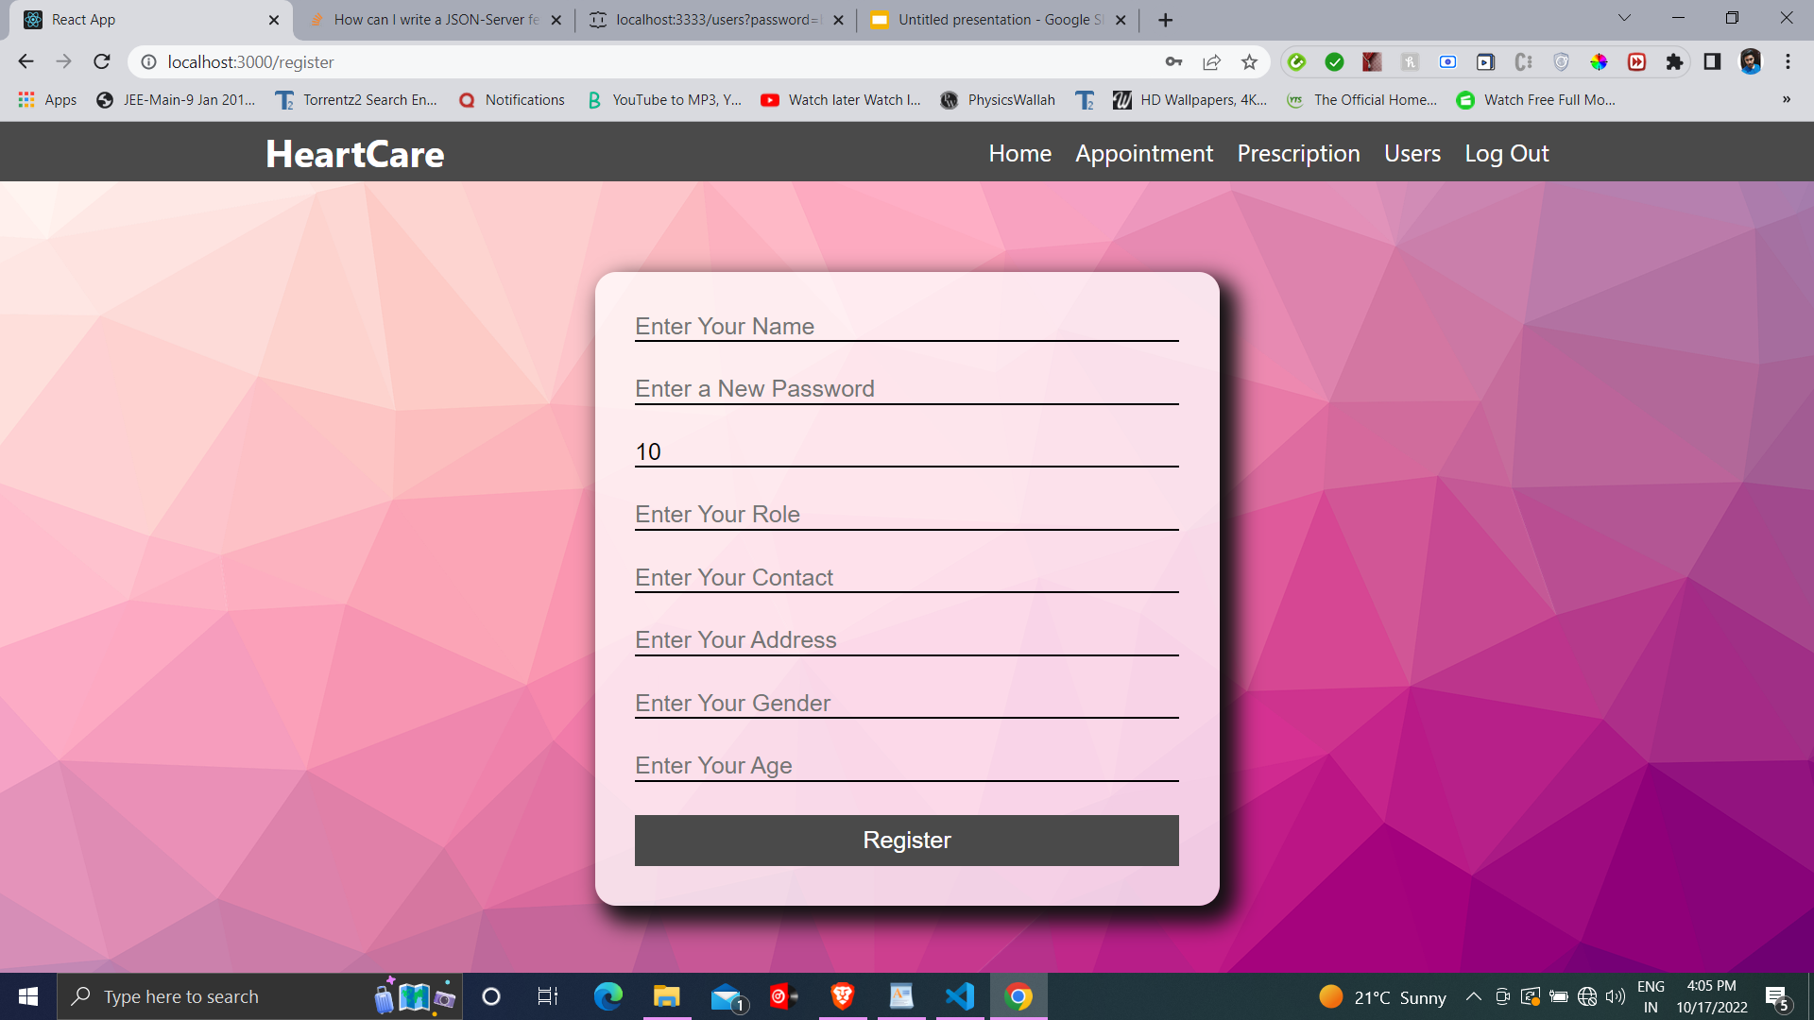
Login & Sign-up Page
The Login page consists of two fields name and password wherein the user must enter the correct data or they are given a warning message for entering wrong data. And the Sign-up page automatically increments the ID of new user.

Slide 6
Logic behind Login Authentication:
When the user enters a Name and Password, we fetch the json array using axios.get() command giving it the following url:
await axios.get(`http://localhost:3333/users?password=${id}&userName=${name.current.value}`)
Here id and password are the values we got in input field. This command returns a promise from which we get the response data. Here we apply the try and catch statements if, the data entered is wrong, the response won’t be fetched and axios will catch an error. And when it does so, we display a message saying that the data entered is wrong.
.catch((error)=>{
if(error.request){
setFound(true)
}
else{
setFound(true)
}
}

Slide 7
STRUCTURE OF OUR APPLICATION:
USERS:
Patient : Can fill a form to set appointment with doctors, can retrieve prescriptions by doctors
Doctor : Can view the recent appointments, can prescribe the patient
Admin : Can approve the users the accounts
PAGES:
Home: Shows the data of user currently logged in, with a change image option, and edit profile button
Appointments: Doctors can see their current appointment, Patients can set appointments,
Prescriptions: Patients may view their prescriptions, and Doctors can recommend them to patients.
Users: Doctors and Patients may view the Users, but can’t handle any other thing, Admin has the rights to approve an account

Slide 8
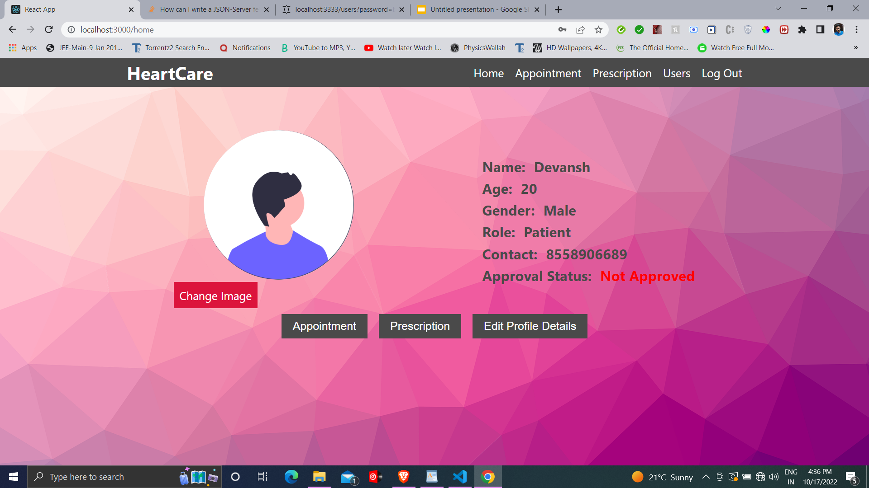
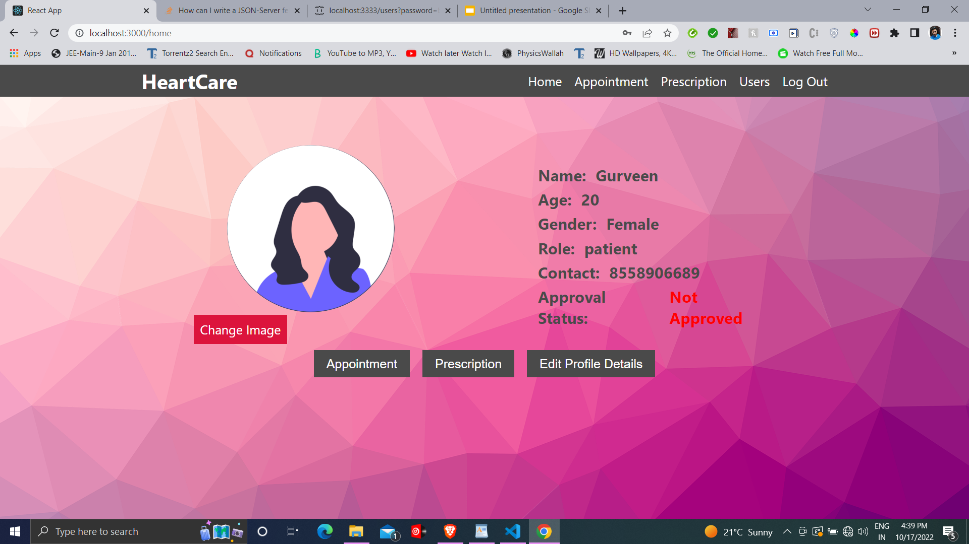
HOME PAGE
Based on User’s gender here we switch the profile picture automatically, on login, or creating a new account.

Slide 9
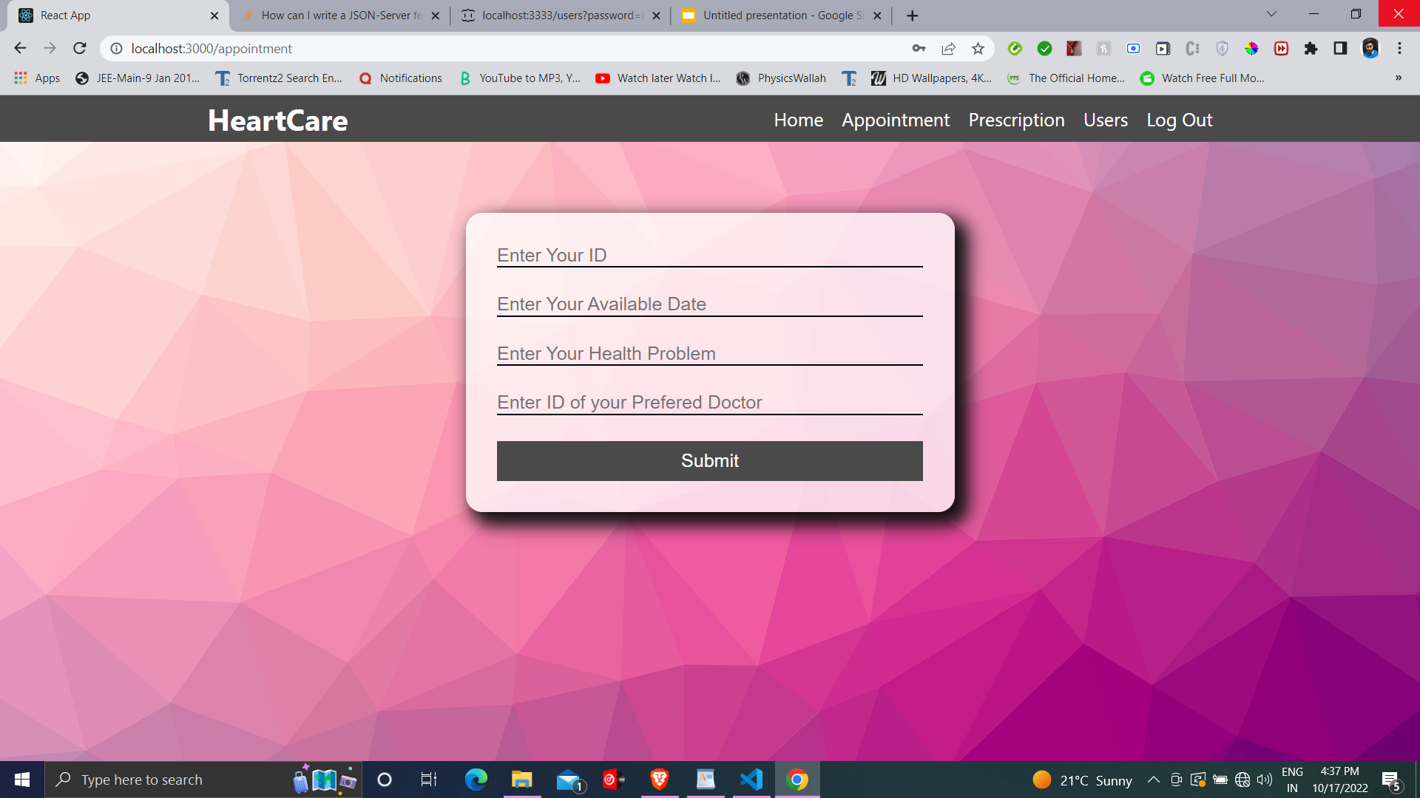
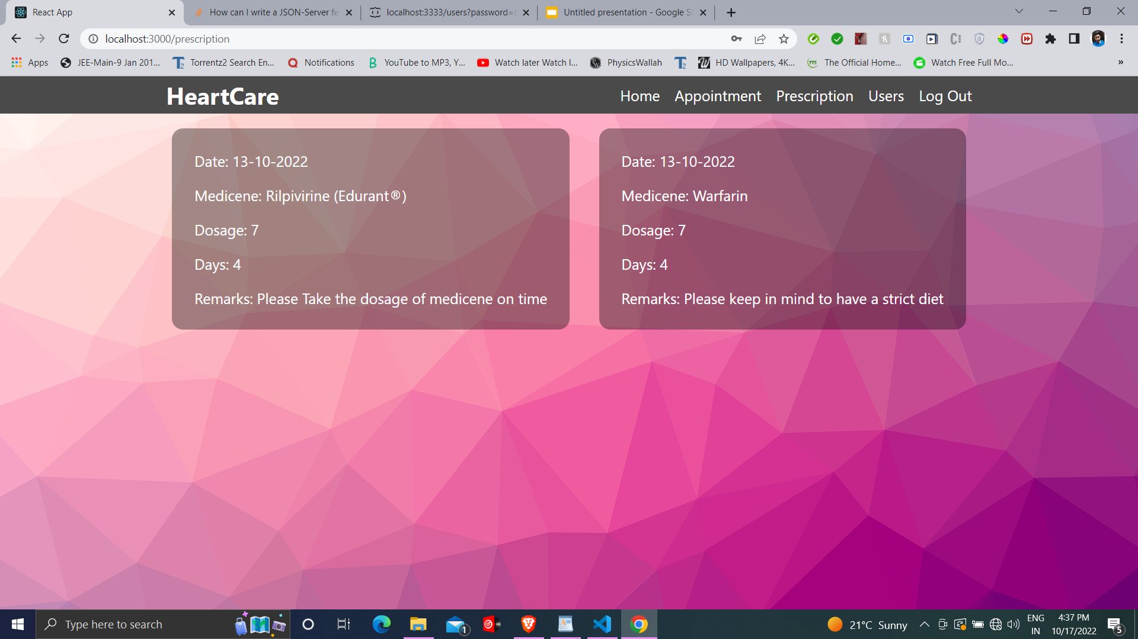
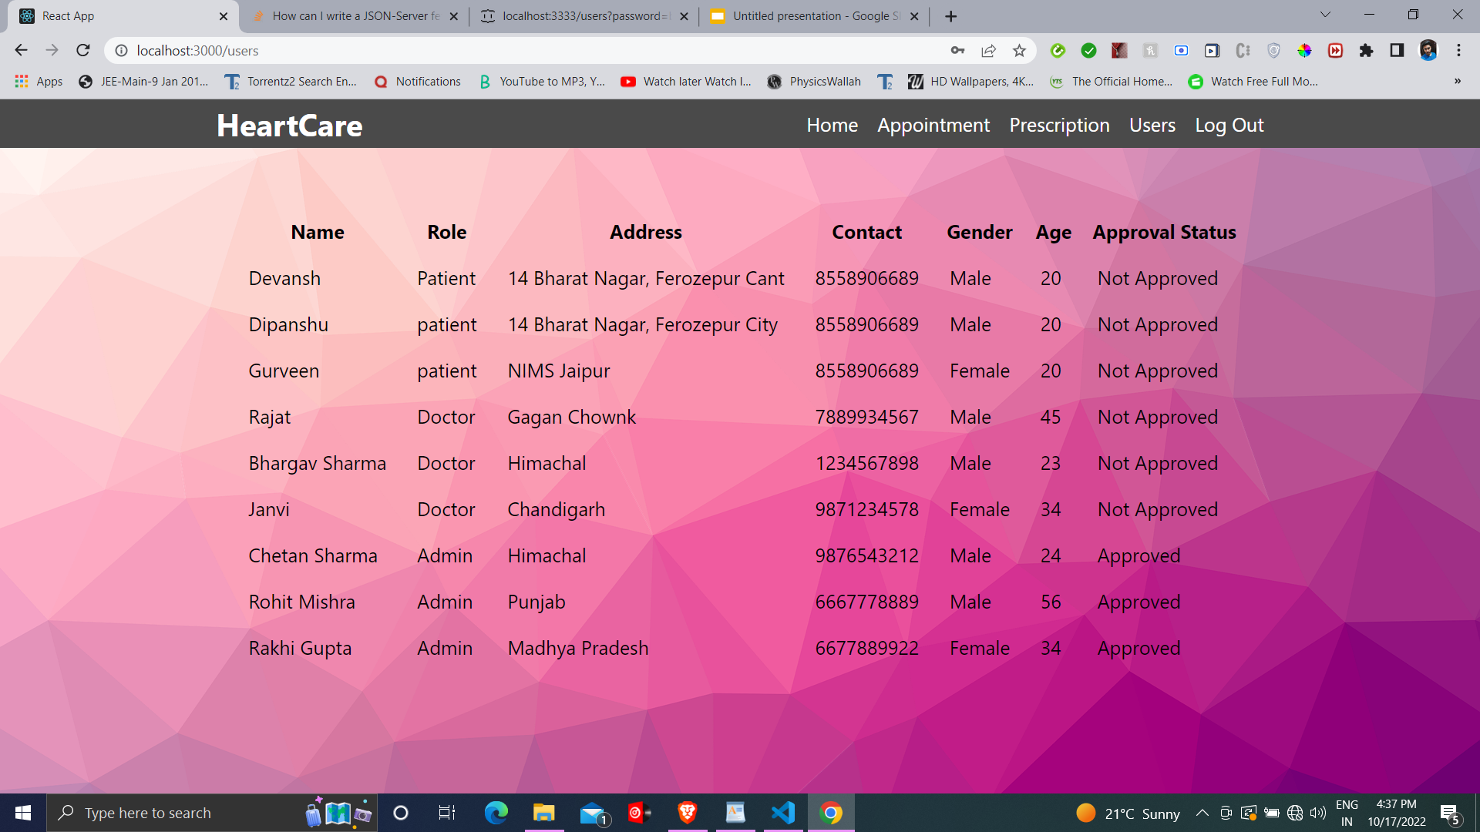
USE CASE 1: PATIENT

Slide 10
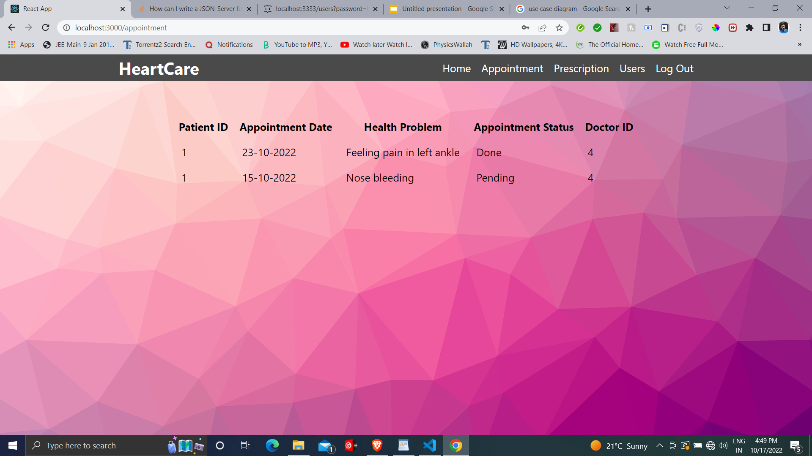
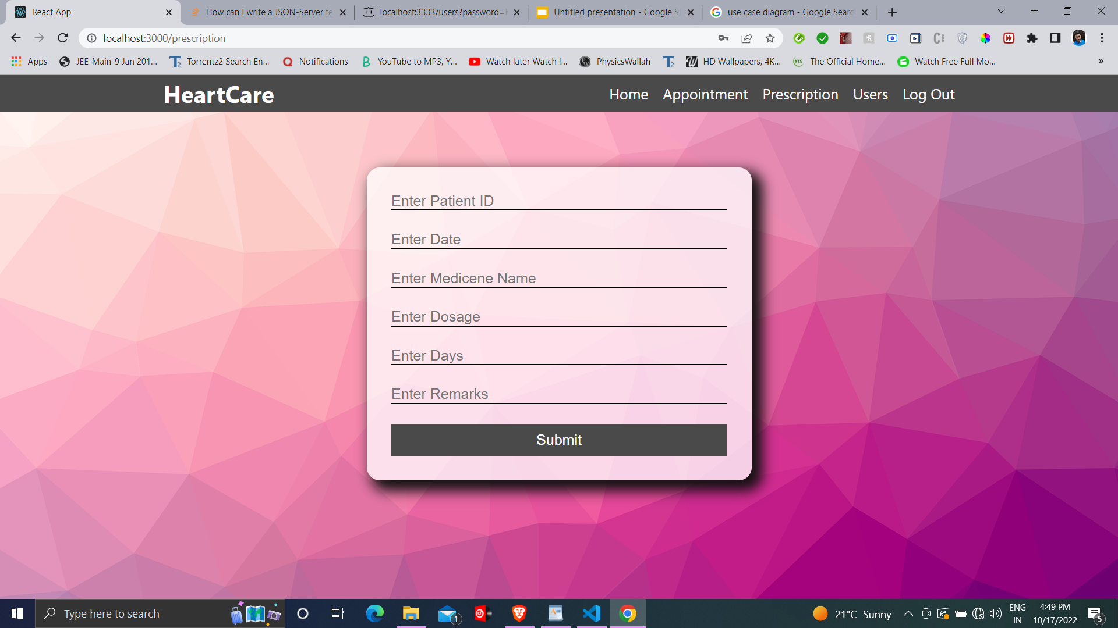
USE CASE 2: DOCTOR

Slide 11
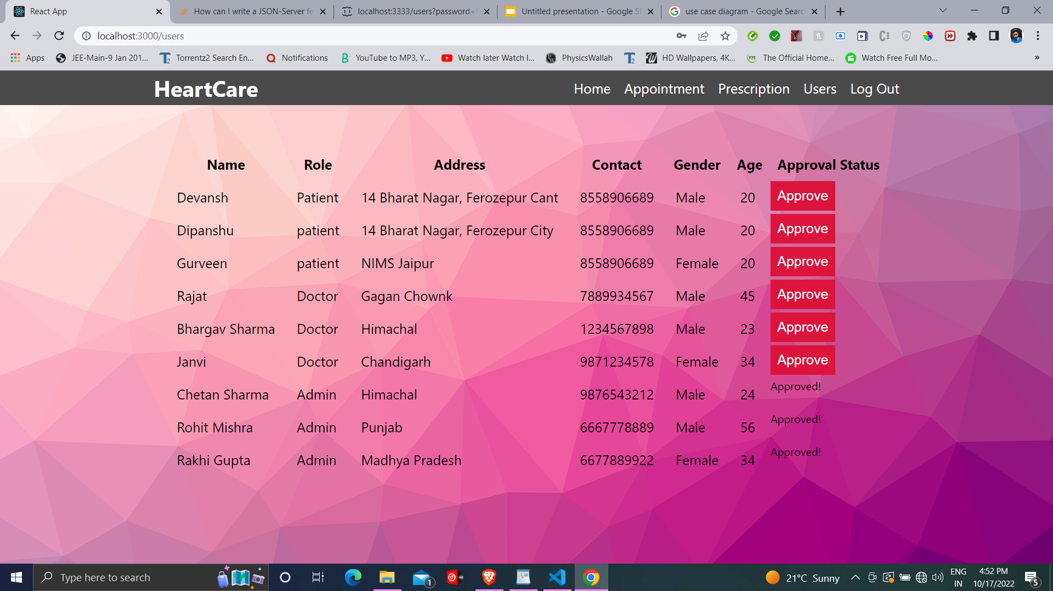
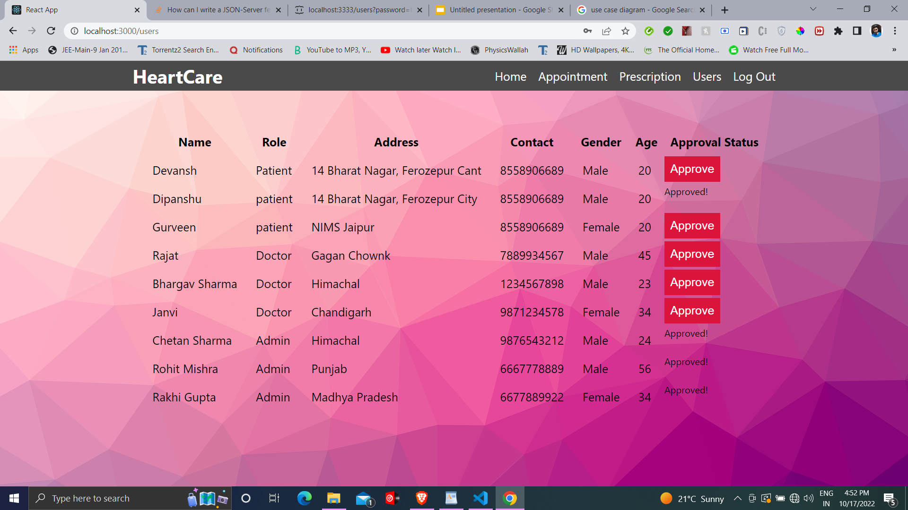
USE CASE 3: ADMIN
Unlike other users, the Admin holds the rights to approve the account of a user as shown in the image.

Slide 12
Logic used:
To switch the content of the three pages according the different use cases is done by using a switch switch statement in our react code. Example:
{
{
"patient":<PatientAppoint/>,
"doctor":<DoctorAppoint/>,
"admin":<div style={{fontSize:"20px",color:"black",padding:"30px"}}>To be accessed by Patient and Doctor Only</div>
}[role]
}
Here our data is switched using the string variable role, which represents the user’s Role

Slide 13
Uploading image
To upload an image we execute the following steps:
Go to the home page, and click the Change Image button.
Now an input field will appear wherein you must fill the url of the image
This image url will be stored in the local storage and thus could be saved later.
On submitting the link, the profile picture of the user will change to the image in url
To avoid clashing of same image with other accounts, on every login the link will be deleted from local storage on every login.

Slide 14




Slide 15
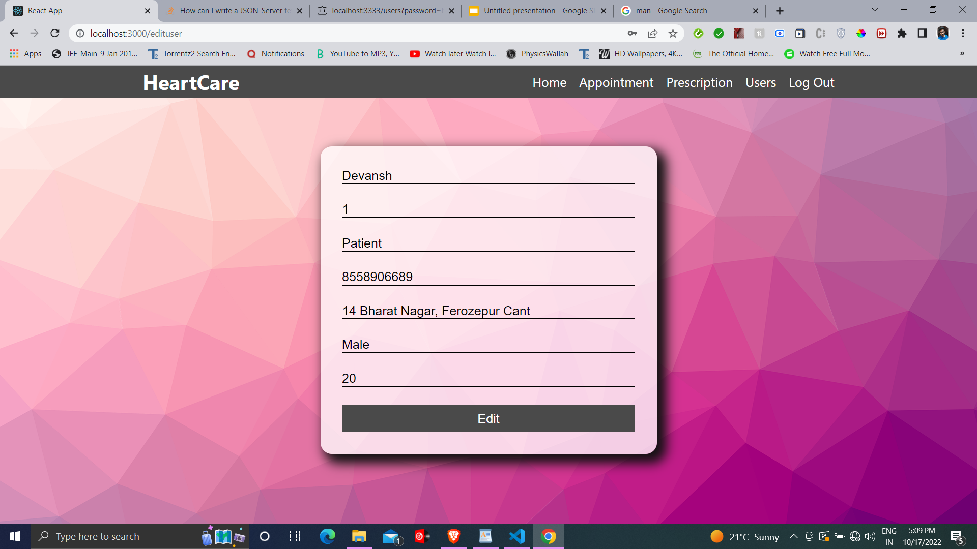
EDIT PROFILE PAGE
In the edit profile page, we fetch the data of current user in the input fields, and from here the user can change the fields and edit his/her data. Here to update our database axios.put(url, newData) command has been used.

Slide 16
THANK YOU!

